Slide 1


Home Automation
Making Smart Homes Smarter

Slide 2

Introduction:
What is Home Automation?
Brief overview of the project's aim
Home automation refers to the use of technology to control and monitor household systems and appliances automatically or remotely. It allows homeowners to manage lighting, climate, entertainment systems, security, and more using smartphones, computers, or voice commands.
This project focuses on creating a smart home system using Arduino and cloud computing technologies. The primary goal is to control home appliances remotely and monitor real-time data (like temperature, motion, etc.) via a smartphone or web interface.

Slide 3
Objective of the project
✅ Remote Control of Appliances
Allow users to turn ON/OFF lights, fans, and other devices from anywhere using a smartphone or web interface.
🌐 Cloud-Based Monitoring
Send real-time data from sensors (like temperature or motion) to the cloud for live monitoring and data logging.
📱 User-Friendly Interface
Integrate with platforms like Blynk, Arduino IoT Cloud, or a custom web dashboard for easy access and control.

Slide 4
Components
Hardware
Software
Arduino UNO/Nano
Relay Module
Sensors (DHT11, PIR, etc.)
Wi-Fi Module (ESP8266)
Arduino IDE
Arduino IoT Cloud
IFTTT

Slide 5
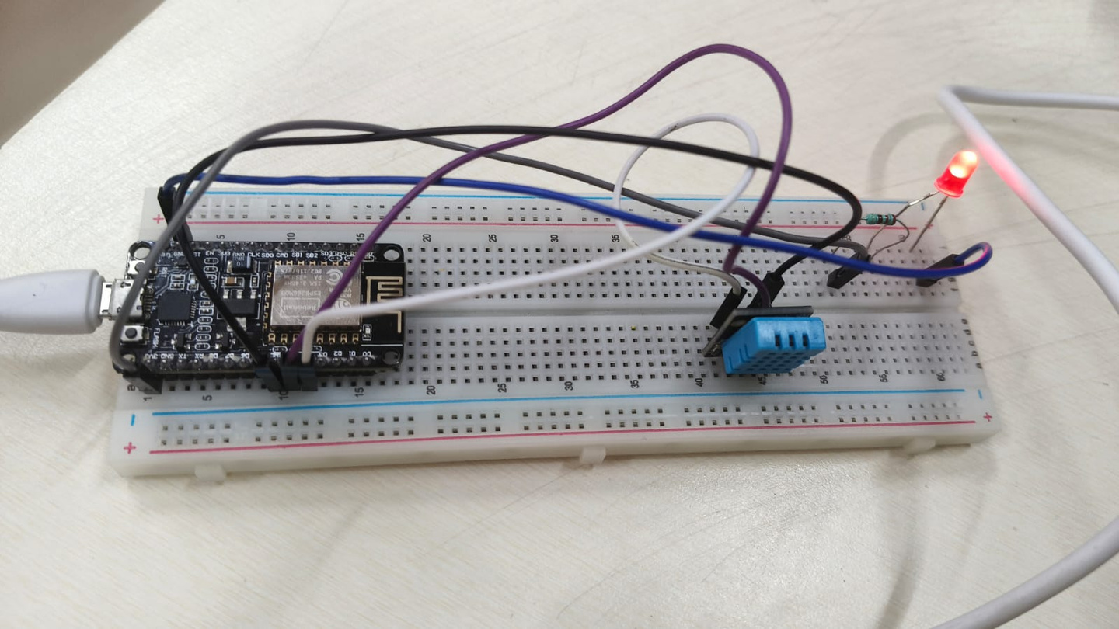
Architecture
Arduino IDE
Arduino IoT Cloud
IFTTT

Slide 6
Code/Working
#include <DHT.h>
#include <ESP8266WiFi.h>
#include <ESP8266HTTPClient.h>
#include "thingProperties.h"
#define DHTPIN 2 // D4 on NodeMCU
#define DHTTYPE DHT11
#define LEDPIN 5 // D1 on NodeMCU
DHT dht(DHTPIN, DHTTYPE);
void setup() {
Serial.begin(9600);
delay(2000);
Serial.println("Initializing...");
initProperties(); // Arduino IoT Cloud properties
pinMode(LEDPIN, OUTPUT);
dht.begin();
delay(2000); // Give DHT time to stabilize
ArduinoCloud.begin(ArduinoIoTPreferredConnection);
setDebugMessageLevel(4);
ArduinoCloud.printDebugInfo();
Serial.println("Setup complete.");
}
void loop() {
ArduinoCloud.update();
readSensor();
}
void readSensor() {
Serial.println("Reading sensor values...");
float t = dht.readTemperature();
float h = dht.readHumidity();
if (!isnan(t)) {
temp = t;
Serial.print("Temperature: ");
Serial.print(temp);
Serial.println(" °C");
if (temp > 30) {
sendToIFTTT(temp);
}
} else {
Serial.println("Failed to read temperature");
}
if (!isnan(h)) {
humid = h;
Serial.print("Humidity: ");
Serial.print(humid);
Serial.println(" %");
} else {
Serial.println("Failed to read humidity");
}
delay(5000); // Delay between readings
}

Slide 7
Advantages
Energy efficiency
Convenience and comfort
Enhanced home security
Scalable and customizable

Slide 8
Features
Remote control of home devices
Real-time temperature & humidity display
Motion detection alerts
Voice control (if integrated with Alexa/Google)

Slide 9
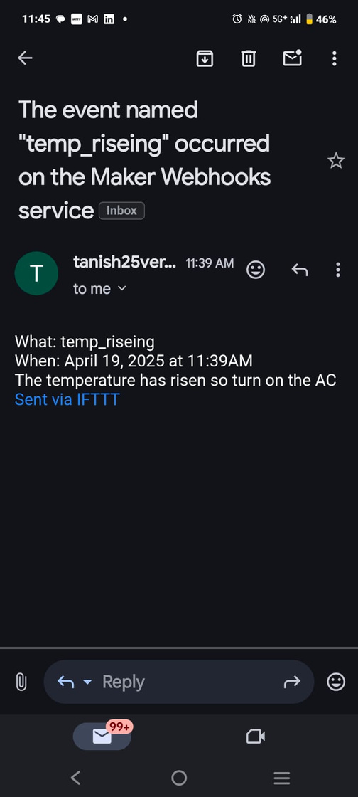
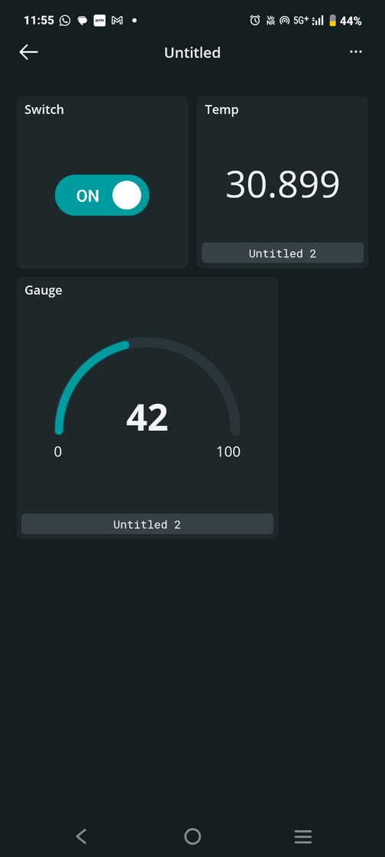
OUTPUT

